Slide 1


Week 10: Coherence and taking stock
Ryan Ka Yau Lai
University of California, Santa Barbara

Slide 2

Before we start …
Open sbc007.rez
If you have a file saved from previous classes, please open that
If not, just open sbc007

Slide 3

Questions for today
Use any example from SBC007 or your assignments to explain the difference between cohesion and coherence.
Or
Tell me how the concepts of cohesion / coherence may apply to your daily life, career, etc.

Slide 4
After today, you will be able to …
Distinguish
Distinguish between cohesion and coherence
Analyse
Analyse cohesion and coherence in natural discourse data
Appreciate
Appreciate further the diversity of strategies for achieving cohesion across individuals, communities, and cultures

Slide 5

Do different people, communities, cultures do cohesion differently?

Slide 6
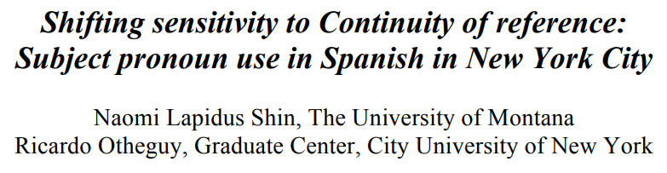
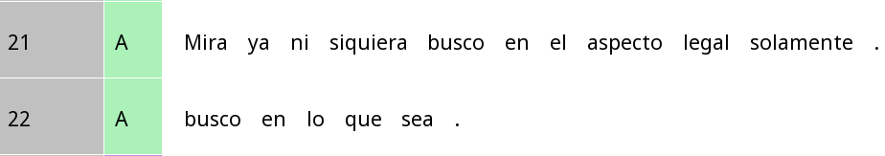
Spanish in NYC vs. Spanish in Latin America
Look (I) am not even looking just in the legal aspect.
(I) am looking everywhere.
Mira (yo) ya ni siquiera busco en el aspect legal solamente
look (I) already not even look in the aspect legal only
(Yo) busco en lo que sea.
(I) look in that which be
Is the choice whether to use pronouns the same for everybody?

Slide 7
Same reference vs switch reference
Same reference
Switch reference
Subject of previous clause = subject of current clause
Int: ¿Y tu papá terminó su licenciatura? (And your dad finished his Bachelor’s?) Part: Nada más. (Nothing more.) <0> se dedicó a otras cosas,
((<0>) dedicated himself to other things,)
Subject of second clause has ____ accessibility
Subject of previous clause = subject of current clause
Part: Ella tenía su novio allá (She had her boyfriend there) y él pensaba venir (And he thought about coming)
Subject of second clause has ____ accessibility

Slide 8
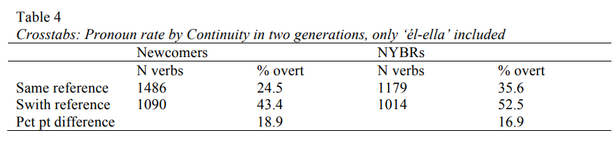
Do accessibility shape referring expressions the same way for everyone?
All subject pronouns | First-gen | Second-gen
Same reference (more acc.) | 23.3% | 31.9%
Switch reference (less acc.) | 37.8% | 41.7%
Difference | 14.5% | 9.8%
Second-generation Latinos in NYC use pronouns more overall
Less affected by accessibility

Slide 9
Do communicative ease shape these differences?
Third-person only | First-gen | Second-gen
Same reference (more acc.) | 24.5% | 43.4%
Switch reference (less acc.) | 35.6% | 52.5%
Difference | 18.9% | 16.9%
First/second-person only | First-gen | Second-gen
Same reference (more acc.) | 26.0% | 35.7%
Switch reference (less acc.) | 43.% | 48.4%
Difference | 17.7% | 12.7%
Second-gen speakers less sensitive to accessibility in first/second person contexts, but not so much in third-person. Why?

Slide 10
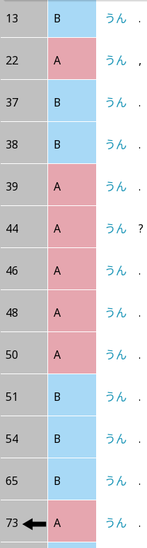
Backchannels in Japanese: Un
This is just one of many backchannels (aizuchi 相槌) …

Slide 11
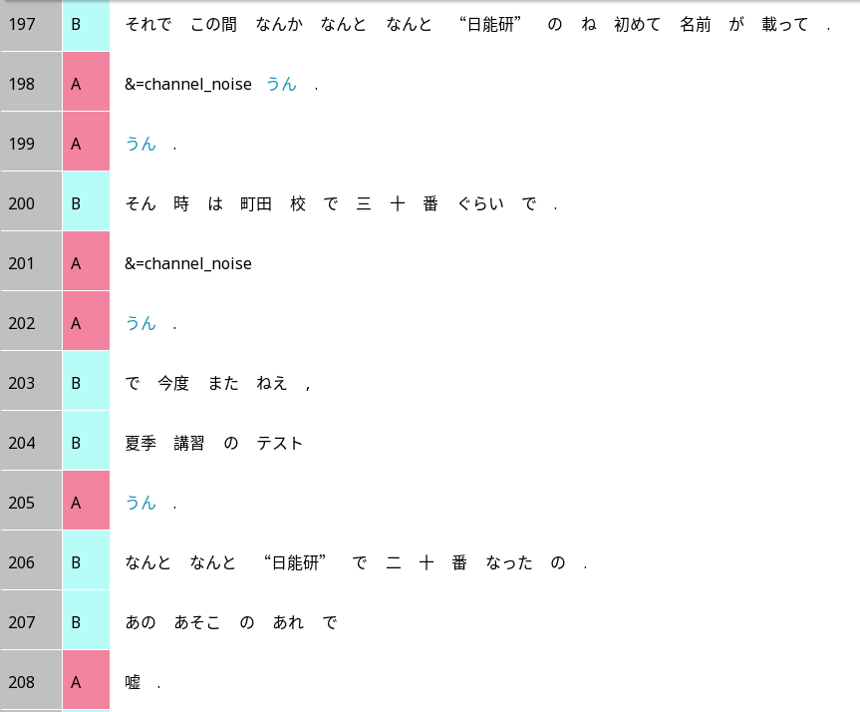
Backchannels in Japanese
Then recently there’s the Nichinouken thing, her name got mentioned for the first time and.
Un.
Un.
A backchannels even when B has not finished a complete utterance.
Line 205: A says ‘un’ even though B has not even produced a complete clause.
At the time she was around 30th in the Machida school and.
Un.
Then the next time,
The test of the summer course,
Un.
Surprisingly she became the 20th in the Nichinouken.
In that thing.
No way.

Slide 12
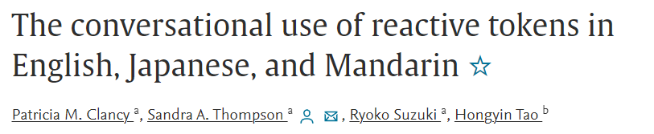
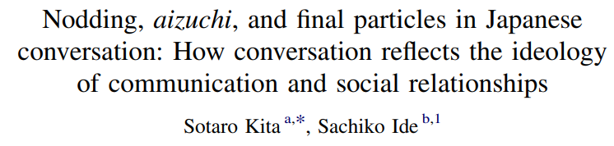
Japanese vs English/Mandarin
Japanese backchannels appear more frequently than English/Mandarin
Japanese backchannels can appear in more contexts than English/Mandarin, e.g. even when the other speaker is not finished
Function of backchannels in English and Mandarin:
Managing the floor: telling the other person ‘I understand, go on’
Function of backchannels in Japanese:
‘coordination for the sake of coordination, like dancing a waltz, through which a social bond between the participants of a conversation is established and maintained’ (Kita & Ide 2007)

Slide 13
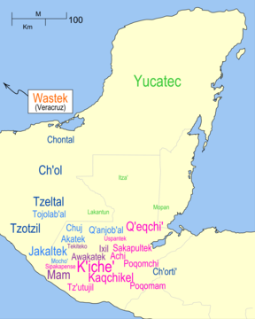
Mayan languages

Slide 14
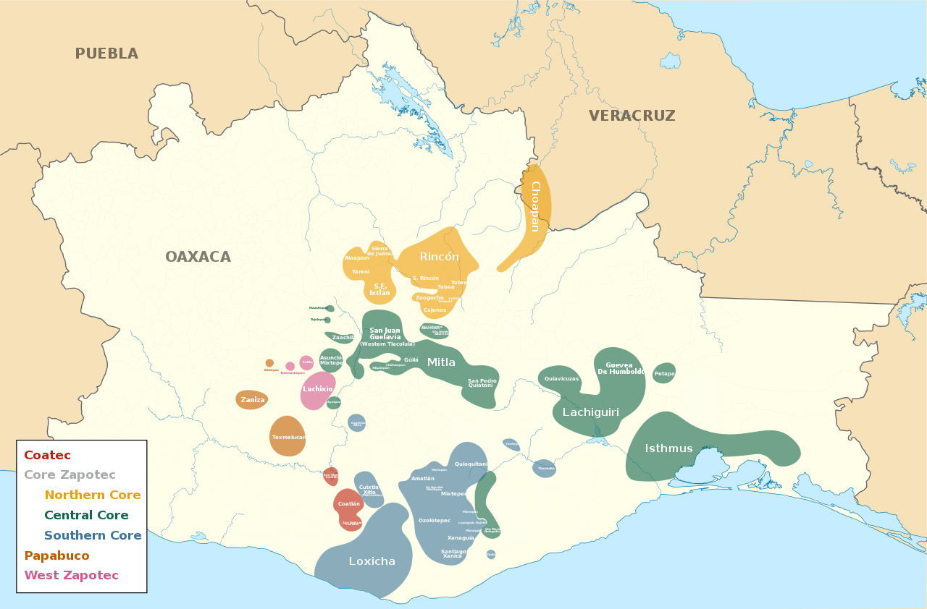
Lachixío Zapotec

Slide 15
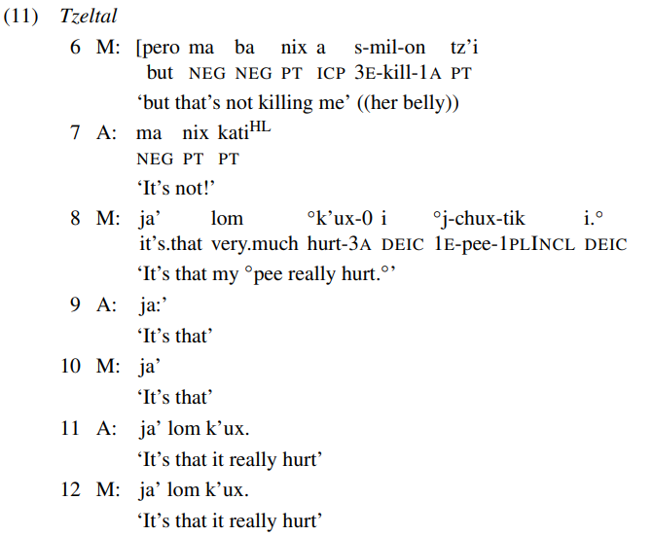
Resonance in Mayan languages
Mayans often use resonance where most other languages prefer interjections (e.g. yes/no, backchannels)
Also found in Zapoteco
From Enfield et al. (2018)
Q: What does this resonance tell you in terms of stance alignment?
Is it different from English (as we saw in the readings)?

Slide 16
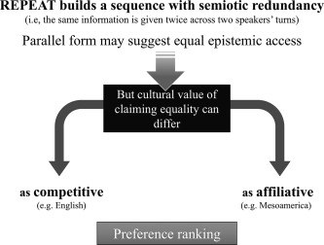
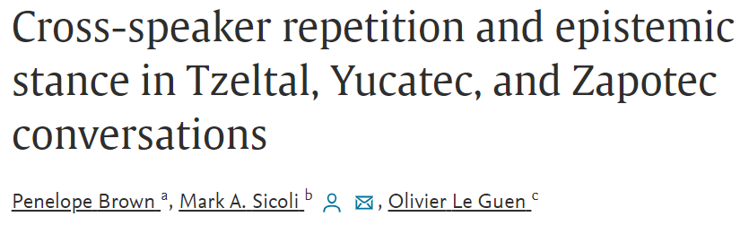
Resonance and stance in Mayan languages and Zapoteco vs. English
Tzeltal, Maya and Zapoteco speakers use resonance more frequently than English speakers
Tzeltal, Maya and Zapoteco use resonance more frequently to express agreement

Slide 17

Autism and cohesion
Neurotypical and neurodiverse children resonate in English in different ways (echolalia) (e.g. Du Bois, Hobson & Hobson 2014)
Neurotypical and neurodiverse children choose to use pronouns in different situations (e.g. Sterponi & de Kirby 2016)

Slide 18
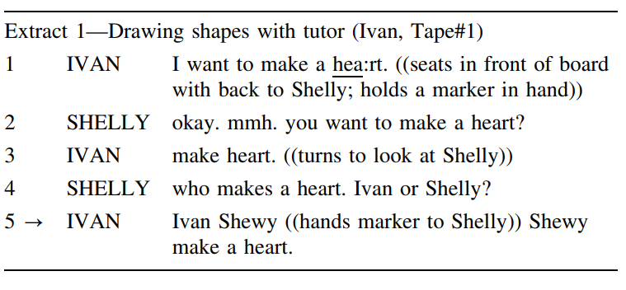
Autism and cohesion
Sterponi & de Kirby (2016)
Different pronoun use can be attributed to factors like resonance
Different resonance patterns are functional, dynamic, responsive to context
Discourse-analytic perspective helps us move beyond deficit framing of autistic children’s linguistic competence

Slide 19
Cohesion vs coherence
Cohesion: A property of the text, as a product
‘Are the different parts of the text connected to each other?’
Coherence: A property of the discourse, as a process
As perceived by speakers
In light of the full linguistic, social, cultural and physical context
‘Given all the context participants have, does this piece of language fit together with what we know?’

Slide 20
Examples of questions on cohesion vs. coherence
 | Cohesion | Coherence
Coreference (Tracks and trails) | Are people referring to the same things over the course of a conversation? | Are people referring to the same things in a way that makes sense for their goals?
Accessibility | Do people use longer expressions for less recently mentioned (longer gapUnits) expressions? | Are people sensibly adapting to their expectations of the cognitive effort required by listeners?
Identifiability | Do people use a definite expression for a referent after it has been established with an indefinite expression? | Are people sensibly adapting to their expectations of whether the referring expression is sufficient for the listener to identify the referent?

Slide 21
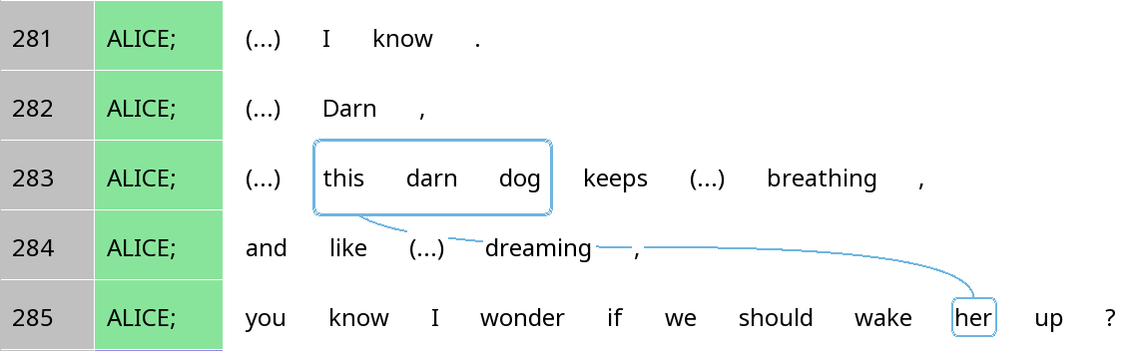
Accessibility, identifiability and coherence
Would this be coherent if Alice and Mary were strangers? If this were a phone call? If the dog were Mary’s and Mary is her boss?

Slide 22
Examples of questions on cohesion vs. coherence
 | Cohesion | Coherence
Interjections / Conjunctions | Are there interjections or conjunctions to show the relationship between different parts of discourse? | Are people choosing interjections/conjunctions in a way that achieves their goals in the interaction?
Resonance | Are people repeating linguistic resources (e.g. words, grammatical constructions) from the preceding context? | Are people repeating linguistic resources to achieve the desired goal (e.g. repair, stance)?

Slide 23
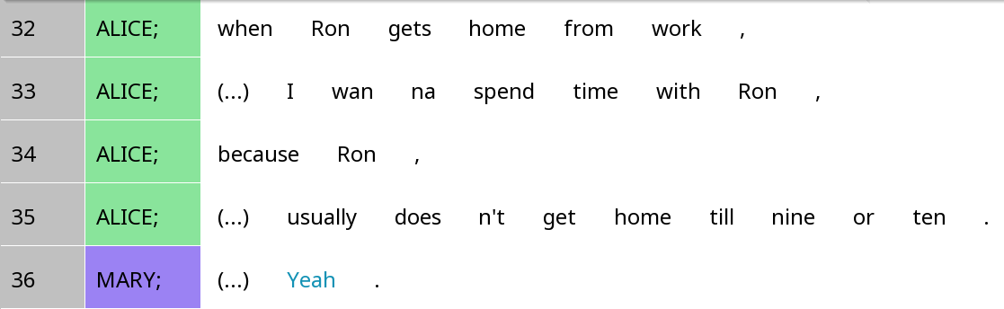
Resonance and coherence
When aligning positively to the speaker, resonance creates cohesion by forming a link between the current and previous turns
But while it may be coherent to do so in Mayan languages, it may not be coherent in English
What if Mary instead says, ‘doesn’t get home till nine or ten.’? Would it still be positive in English?

Slide 24
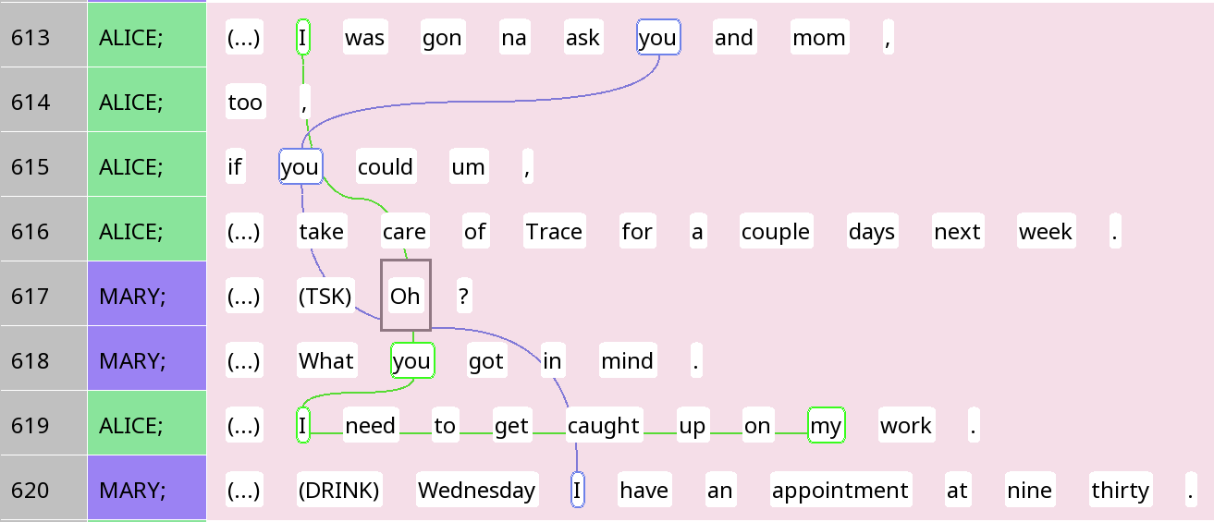
Where does coherence come from when cohesive ties are limited?

Slide 25

Your turn!
Using an example from SBC007 or one of your shows/mini-papers, explain the difference between cohesion and coherence.
Any part that is highly cohesive, but might be incoherent in a different context?
Any part that is highly coherent, but displays few cohesive ties?
Tell your partner what you’ve found.

Slide 26
Where to go from here?
Looking more into coherence: LING 170
More details about transcription: LING 212
Quantitative analysis: LING 120, rezonateR extra credit assignment
Computational approaches: LING 111, ChatGPT extra credit assignment
Join our research group: LING 199
Join my summer class: LING 197

